Slide 1
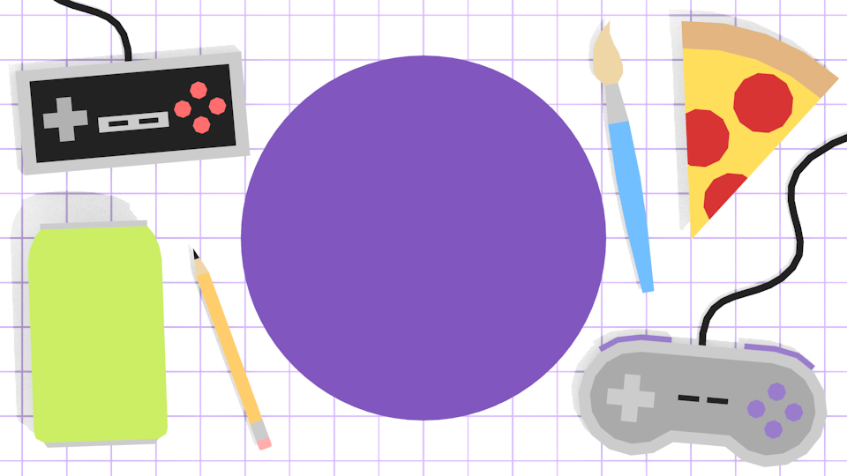

Unity 101
Welcome!
We’ll start shortly-- meanwhile…
Download Unity Hub if you haven’t and then get Unity through Unity Hub
Notes:
*Stress that they should really get unity installed before the next workshop
5 min : ice break
5 min : UI
20 min: game object/component
5 min: prefab
25 min: physics

Slide 2
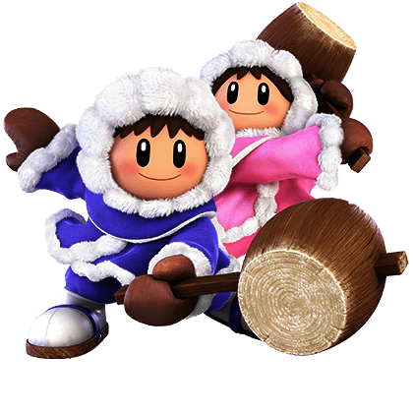


Slide 3
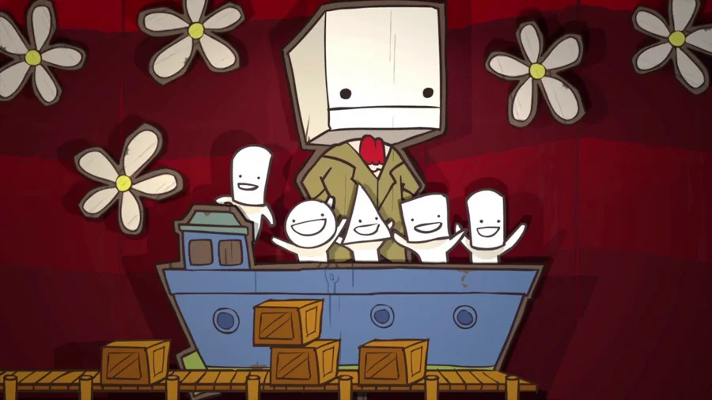
What is your favorite game and why?
What’s your favorite Pokemon and why?
What do you want to do in game dev?
Not knowing yet is also a good answer :D

Slide 4
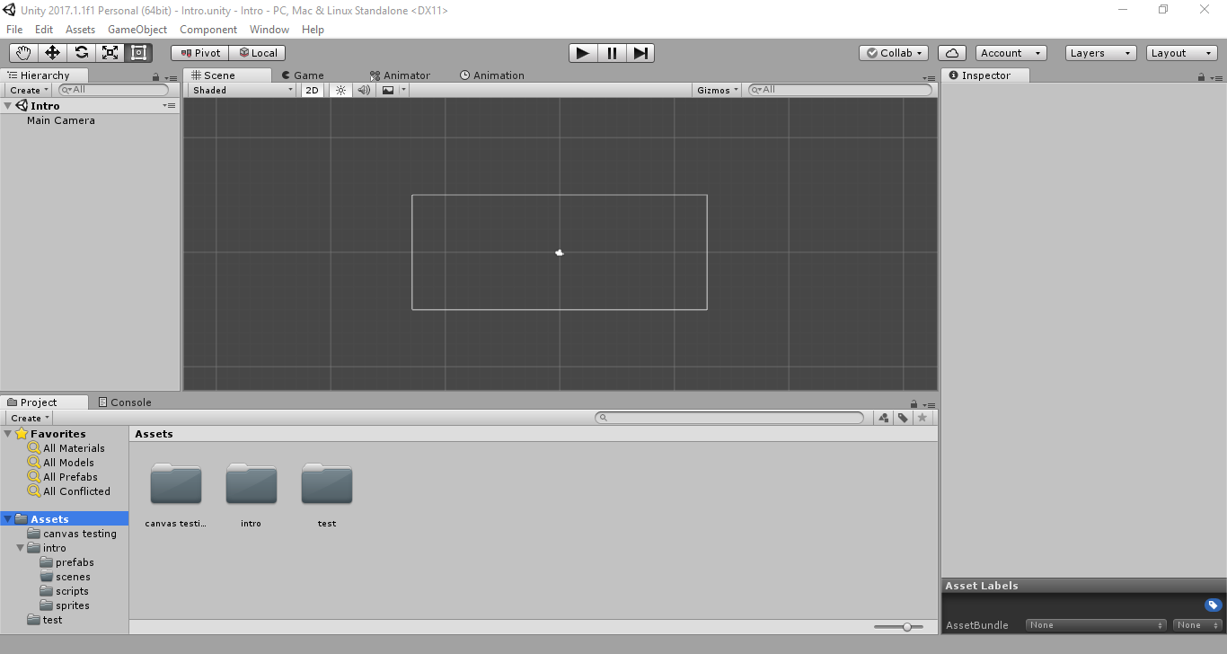
Navigating Unity
Scene View
Hierarchy
Inspector
File Explorer
Notes:
Explain that you can import files by clicking an dragging into file explorer

Slide 5
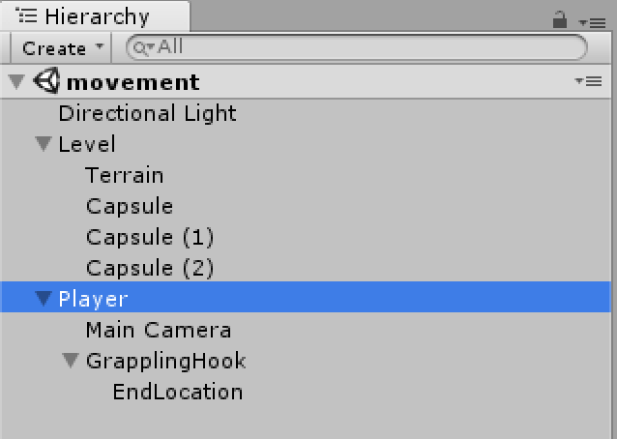
Hierarchy
The Hierarchy shows a scene and all the gameobjects in it.
All the active gameobjects live in the active scene, shown here

Slide 6
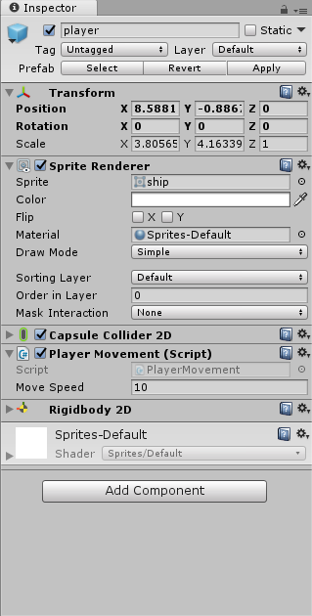
Now what’s a game object?
Every part of your game is a game object that holds components
A game object is an object that exists in your scene
They’re players, platforms, balls
A game object can have child game objects
Notes:
Add sprite to scene, then explain

Slide 7
What’s a component?
A component is something that is attached to your game object that gives it behavior
For example:
a component to give your object physics
a component to handle movement
a component to spawn enemies
Notes:
Add sprite to scene, then explain

Slide 8
Prefabs
Prefabs are saved states of game objects.
Prefabs will save the components and components’ settings of the game object as well any child game object, their components, and their components’ settings

Slide 9
Physics & Collisions
Game Objects need physics applied to interact with each other in a natural way.
Colliders define the area where game objects will interact
Rigidbodies define how game objects react to physics
Colliders and Rigidbodies can be found in Add Component > Physics2D
Notes:
Add platforms, start adding colliders and rigidbodies.
Show what the play/pause/next frame buttons do.

Slide 10
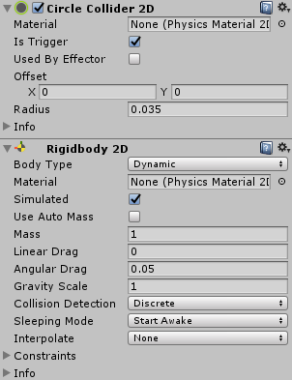
Dynamic vs Kinematic vs Static
Dynamic: under the full control of physics
Kinematic: not affected by forces like gravity or by collisions, but may be moved by other means
Static: object should never move
Kinematic and Static objects will only collide with Dynamic objects
Notes:
Show effects of triggers

Slide 11
Triggers
Is Trigger checked means the area defined will not be solid and other game objects can pass through
Use a Trigger when you want to detect when another collider is within the defined area without blocking it
Notes:
Show effects of triggers

